Slide 1
Growing Maryland Wine Industry Together
What the industry wants and needs
Joyce Rigby
Rigby Viniculture LLC
2020 Maryland Grape and Wine Industry Conference

Slide 2
Maryland Wineries Association Grape Grower Initiative
1. Develop financial tool to be used by prospective growers to estimate the costs and potential income associated with establishing and maintaining a vineyard.
2. Employ the tool under different scenarios to evaluate potential economies of scale.
3. Demonstrate tool to prospective growers at seminars around the state.

Slide 3
Advisory Panel Members
Kevin Atticks, Executive Director, Maryland Wineries Association
Ed Boyce, Owner, Black Ankle Winery
Robert Butz, Owner, Windridge Vineyards
Phineas Deford, Boordy Vineyards
Dr. Joe Fiola, Viticulture Extension Specialist, University of MD
John Levenberg, Director of Winemaking, The Wine Collective

Slide 4
Top Ten Varieties Wanted
Varieties | Tons | Percent of Total | Number of Wineries that want this grape
Cabernet Franc | 97 | 15% | 25
Vidal Blanc | 64 | 10% | 15
Merlot | 61 | 9% | 15
Cabernet Sauvignon | 46 | 7% | 12
Chardonnay | 46 | 7% | 11
Albariño | 33 | 5% | 10
Traminette | 32 | 5% | 6
Petit Verdot | 30 | 4% | 10
Viognier | 30 | 4% | 9
Chambourcin | 25 | 4% | 8
TOTALS | 464 | 65%

Slide 5
Other Varieties
Varieties | Tons | Percent of Total | Number of Wineries that want this grape
Sauvignon Blanc | 25 | 4% | 6
Barbera | 23 | 3% | 11
Petit Manseng | 22 | 3% | 3
Pinot Gris/Grigio | 19 | 3% | 6
Riesling | 17 | 3% | 4
Tannat | 16 | 2% | 5
Malbec | 13 | 2% | 4
Chardonel | 9 | 1% | 3
Gruner Veltliner | 8 | 1% | 4
Lemberger | 7 | 1% | 3
Chenin Blanc | 6 | 1% | 4
TOTALS | 165 | 24%

Slide 6
Current Fruit Sources for Maryland Wineries
OVERALL | %
Estate | 50.8
Other MD Growers | 20.1
West Coast | 16.9
Other Mid-Atlantic States | 9.4
Chile | .9
Other | 2.0

Slide 7
Number of Wineries….
 | Number of wineries | % of Total
That have bought grapes/juice from out of state | 35 | 67%
That are seeking to purchase grapes | 38 | 76%

Slide 8
Importance of Buying Maryland Grapes
 | Number of Wineries | % of total
Extremely Important | 4 | 8%
Very Important | 22 | 45%
Important | 16 | 33%
Some Importance | 7 | 14%
Not Important at all | 0 | 0
TOTAL RESPONSES | 49
53%
86%

Slide 9
How Do Wineries Prefer to Pay?
 | Number of Wineries | % of total
By the ton | 41 | 93%
By the acre | 3 | 7%
Additional Incentives
 | Number of Wineries | % of total
Multi-year contract | 27 | 46%
Quality Incentives | 31 | 53%

Slide 10
Winery and Grower Relationship
Contract
Examples on internet
Communication
Accurate crop estimates
When to harvest, when to deliver
Quality
Fruit upon delivery
Risk
Will the winery assume any? Consider contract $/acre
Level of Trust
Will the vineyard provide premium fruit
Will the winery pay on time

Slide 11
Communication
During the growing season
Any issues of concern
Representative of winery should make 2-3 visits to check vine and fruit health
Estimate crop loads after veraison or at lag phase
Logistics – winery needs to know
When the fruit will be delivered
How much fruit is being delivered
Don’t expect to pick only on weekends

Slide 12
Quality Expectations
Grow as good or better fruit than the purchasing winery
Disease-free, rot-free fruit, MOG free
Clean fruit – sort out rotten berries in the field. Expect picking to take longer when you have to do this
Fruit that is harvested according to winery’s specifications
Maturity
Sugar and acid levels
Fruit temperature
Expedient picking – get the labor you need to pick as fast as the winery desires
Avoid picking in the heat of the day
Store and Deliver grapes via a refrigerated truck

Slide 13
Assumptions
Varieties and Income
Expenses Not Included
Capital Expenses
Installation Expenses
Maintenance Expenses
Vineyard Layout
Vineyard Management

Slide 14
Income
There is no income in the first year
The second-year income can be assumed to be ¼ to ½ of the third year’s income
Potential income numbers represent full production which can be achieved in the third year (with closer spacing, cane pruning and efficient viticulture)
The income numbers can be extrapolated into a business plan and duplicated each year with some changes due to market factors

Slide 15
Varieties
Chosen based on survey to Maryland Wineries and what they would purchase
18 vinifera varieties
4 hybrid varieties
Prices per ton based on Advisory Panel consensus after looking at prices in MD, VA, and the Finger Lakes. These figures represent average prices. Varieties may differ from these figures.
 | $ per ton
Red Vinifera | 2700
White Vinifera | 2200
All Hybrids | 1200

Slide 16
Purchasing Grapes
How much more $/ton would you pay for MD fruit vs. out of state?
Outliers $3000/ton and $1/ton omitted Number of Responses: 20
Low | $100
High | $1,600
Median | $350
Average | $489
Std. Deviation | $386

Slide 17
Purchasing Grapes
 |  | What did you purchase in 2018 and what did you pay 27 wineries responded
Top 10 Varieties Desired | Number of tons desired | Number of tons purchased 2018 | Number of Responses | MD 2018 Average Price | Finger Lakes 2018 Average Price | VA 2017 Average Price
Cabernet Franc | 97 | 17 | 7 | $ 1,971 | $ 1,573 | $ 2,407
Merlot | 61 | 15 | 5 | $ 2,160 | $ 1,828 | $ 2,408
Cabernet Sauvignon | 46 | 13 | 4 | $ 2,475 | $ 1,750 | $ 2,385
Petit Verdot | 30 | 16 | 5 | $ 1,840 |  | $ 2,492
Chardonnay | 46 | 16 | 5 | $ 1,680 | $ 1,382 | $ 2,297
Albarino | 33 |  |  |  |  | $ 1,988
Viognier | 30 | 5 | 1 | $ 1,500 | $ 1,800 | $ 2,462
Vidal Blanc | 64 | 25 | 9 | $ 1,144 | $ 633 | $ 1,548
Traminette | 25 | 6 | 2 | $ 800 | $ 793 | $ 1,406
Chambourcin | 32 | 5 | 1 | $ 1,200 | $ 800 | $ 1,522
Notes:
1. I took out the vinifera values <$1000; I am assuming they came from West Coast
2. This question used ranges, for both tons and $/ton. The median of each range was substituted for this analysis

Slide 18
Vineyard Only: Sell Grapes
Varieties | acres | tons/ acre | total tons | $ per ton | Potential Grape Gross income
White hybrid | 5 | 7 | 35 | $ 1,200 | $ 42,000
Red hybrid | 5 | 8 | 40 | $ 1,200 | $ 48,000
White vinifera blend | 5 | 3 | 15 | $ 2,200 | $ 33,000
Red vinifera blend 1 | 10 | 3 | 30 | $ 2,700 | $ 81,000
Red vinifera blend reserve | 5 | 3 | 15 | $ 2,700 | $ 40,500
TOTALS | 30 |  | 135 |  | $ 244,500

Slide 19
Vineyard + Winery: Sell Wine
Varieties | Gallons finished wine | Cases of wine | $/ bottle | Potential Wine Gross Income
White hybrid | 5250 | 2210 | $ 18.00 | $ 477,474
Red hybrid | 6000 | 2526 | $ 18.00 | $ 545,684
White vinifera blend | 2250 | 947 | $ 27.00 | $ 306,947
Red vinifera blend 1 | 4500 | 1895 | $ 26.00 | $ 591,158
Red vinifera blend reserve | 2250 | 947 | $ 35.00 | $ 397,895
 |  | 8525 |  | $ 2,319,158

Slide 20
Vineyard Only: Sell ton of grapes for 100 x bottle price
Varieties | acres | tons/ acre | total tons | Factor of 100 $ per ton | Factor of 100 Potential Grape income
White hybrid | 5 | 7 | 35 | $ 1,800 | $ 63,000
Red hybrid | 5 | 8 | 40 | $ 1,800 | $ 72,000
White vinifera blend | 5 | 3 | 15 | $ 2,700 | $ 40,500
Red vinifera blend 1 | 10 | 3 | 30 | $ 2,600 | $ 78,000
Red vinifera blend reserve | 5 | 3 | 15 | $ 3,500 | $ 53,500
TOTALS | 30 |  | 135 |  | $ 307,000
vs. Market Price $ 244,500

Slide 21
Expenses Not Included in Tool
Cost of Land
Site Preparation Costs
Consultant Fees (soil + viticulturalist)
Vineyard Design Costs (surveyor + viticulturalist)
In other words, site is ready to plant

Slide 22
Capital Expenses - Equipment
All quotes are based on 2019 pricing for new equipment received by various equipment vendors
There are places in the tool that allow you to change these numbers to match your quotes
You may get better numbers through volume discounts
You may find used equipment
You may use different vendors
The number of items of equipment needed for different acreage was agreed upon by the Advisory Panel – you can change these quantities, as well

Slide 23
Installation Expenses
Expenses are based on per row costs. Each spacing has a different number of rows per acre.
Included are:
Trellis materials and Labor to install
Vines and planting costs
Labor to maintain vines through the first year
Chemical costs for first year

Slide 24
Maintenance Expenses
Maintenance expenses include all costs other than capital (asset) costs and begin in the 2nd year
Vineyard Manager
Vineyard Labor – based on 4.5 acres per man at 8’ spacing
Farm/grounds personnel
Annual supplies
Chemicals
These expenses can be extrapolated into a business plan and duplicated each year with some changes due to market factors

Slide 25
Vineyard Layout
500’ row length
Vine spacing is set at 40” for vinifera and 48” for hybrids
This spacing is best for cane pruning
Row spacing can be chosen from the following: 7’,7.5’,8’,8.5’, and 9’
Trellis costs per row are the same – row posts are spaced at 20’
Row Widths in feet | 7 | 7.5 | 8 | 8.5 | 9
Number of rows/acre | 12.5 | 11.7 | 10.9 | 10.3 | 9.7

Slide 26
Vineyard Management
Labor requirements are based on 4.5 acres/man at 8’ spacing. Other spacings are extrapolated from there
Cane Pruned
Vertical Shoot Positioned (VSP)
Mechanization is employed
Hedging
Leafing
Cultivating
Hand harvested for best fruit conditions
Use of harvest lugs (hold about 25 lbs) over harvest bins (hold ½ ton)

Slide 27
Why Cane Pruning
Old wood (on a cordon) is a reservoir for overwintering disease, Phomopsis in particular
Easier to teach, easier to learn
Pruning decisions are easier
Less shoot thinning (only one pass is needed vs 2 or more passes with spur pruning)
Some say more tying – yes you have to tie your canes to the fruiting wire each year. But, when working with cordons, esp. wide spacing, you are always replacing cordons and tying.

Slide 28
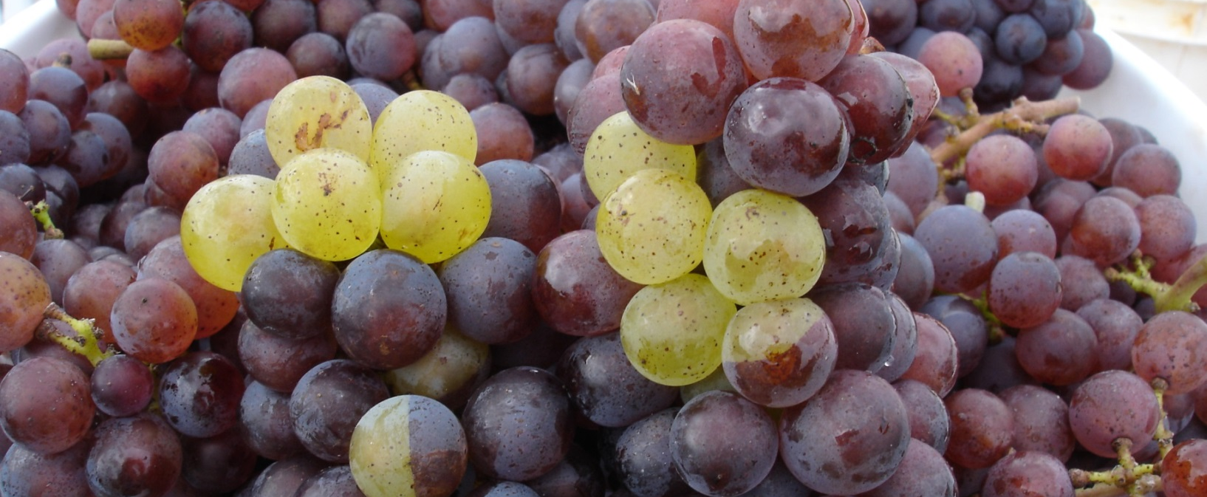
Maryland Wineries Association and
My Advisory Panel:
Kevin Atticks
Ed Boyce
Robert Butz
Phineas Deford
Joe Fiola
John Levenberg
Maryland Grape Growers Association
Thank You!
rigbyviniculture@gmail.com

