Slide 1


A Review of Grape Diseases and Their Management
Mengjun Hu
Department of Plant Science and Landscape Architecture
University of Maryland

Slide 2
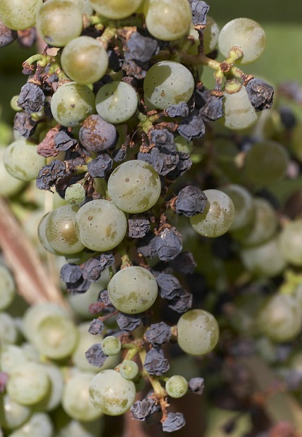
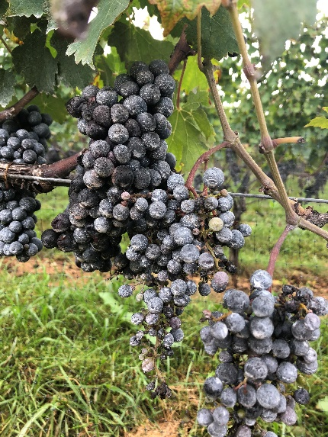
What is a Plant Disease ?
Biotic Disease: Very common
Caused by living microorganisms such as fungi,
bacteria, and viruses.
Abiotic Disease or Disorders: Less common
Caused by noninfectious factors such as water/heat stress,
nutrient deficiencies, soil pH, and soil structure.

Slide 3
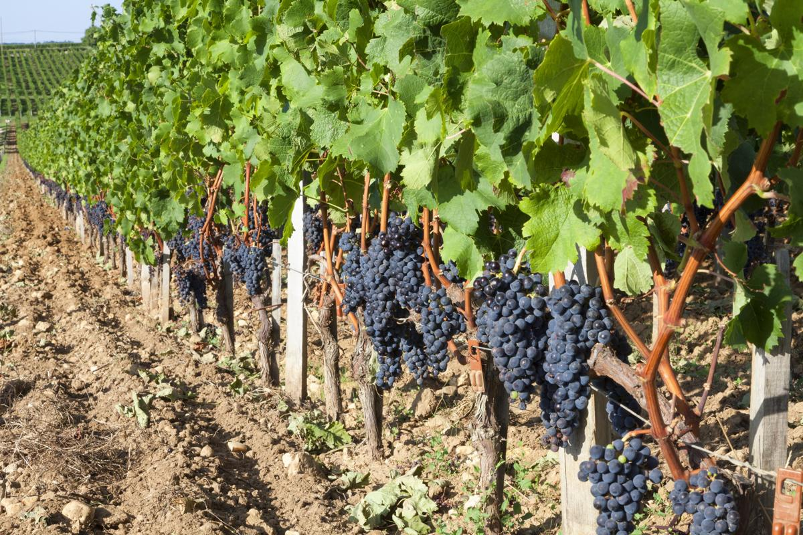
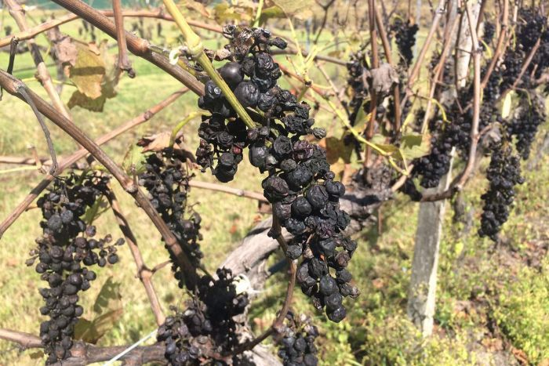
Importance of Grape Diseases
Short term:
Reduce yield, and fruit / wine quality
Reduce vine vigor → reduced yields
Long term:
Shorten longevity of the vineyard

Slide 4
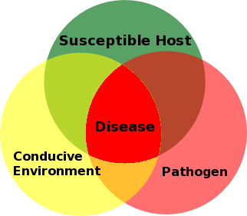
Disease Triangle – factors required for biotic disease infections

Slide 5
Major Grapevine
Diseases in the Mid-Atlantic
Downy Mildew (oomycete)
Late Season Bunch Rots * (mainly caused by fungi)
Black Rot (fungal disease)
Phomopsis (fungal disease)
Powdery Mildew (fungal disease)
* A variety of bunch rots caused by multiple pathogens

Slide 6
When do you manage fungal fruit diseases? It depends on the disease!
Late-season rots
Risk Period for diseases
Downy mildew
Powdery mildew
Phomopsis
Black rot
Bud break Pre-bloom Bloom Post-bloom Bunch Closure Veraison Pre-harvest Post-harvest
Phenology

Slide 7
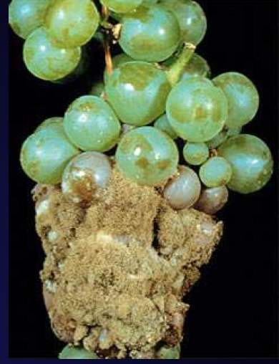
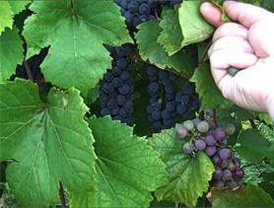
Important Principles for Disease Management
CHEMICALS. Fungi (including oomycete) are the only pathogen group you can control with chemicals
  All major fungal pathogens are at risk of becoming resistant to single site of action chemical groups
  Limit each fungicide group (FRAC codes) to 2 times a season
  Use primarily multi-site fungicides
TIMING. Fungal pathogens vary timing of chemical control
  Scouting and accurate disease identification are key to effective chemical use
  Understand the environmental conditions under which you need to spray
CANOPY MANAGEMENT. Critical for control fungal fruit, leaf and cane diseases
  → Reducing humidity reduces infections
  → Canopy management increases penetration of pesticides

Slide 8
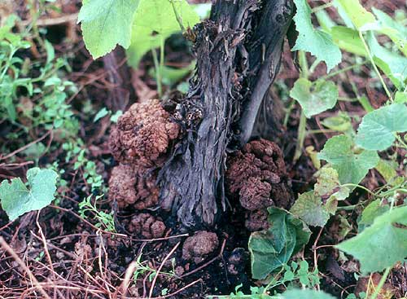
Important principles for disease management
4. INOCULUM SOURCES. Reduce disease pressure and epidemics of fungal diseases by managing overwintering inoculum
  → If survival is in wood: Dormant sprays kill overwintering inoculum on wood
  → If survival is in berries, canes, and debris: Remove from the canopy; spring cultivate, mulch, remove or burn to suppress spread
5. CLEAN STOCK. Important for ALL plant pathogens, but is the ONLY preventative management option for viruses and crown gall
6. Only some things can be cured
  -There is no cure for viruses, crown gall, root rot or trunk canker diseases
  - Once it’s in the plant, removal would be the only option

Slide 9
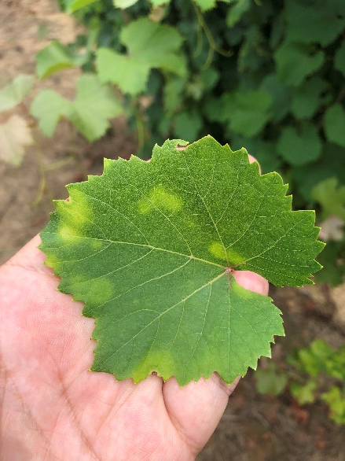
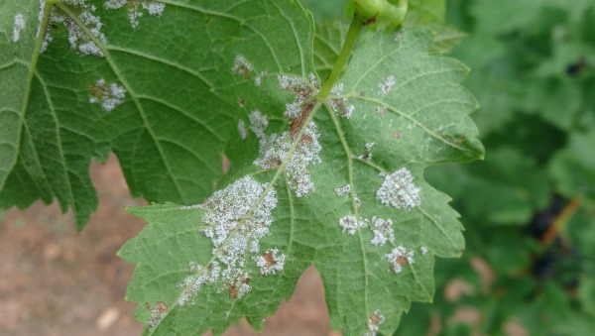
Downy mildew (a primary leaf disease)
Epidemics cause major yield losses
Diagnostic symptoms
-Leaf spots with white powder on leaf underside
-Infections berries turn light brown and soft, and are often covered with the white mycelium
The fungus overwinters on ground in infected leaves.
Berries become resistant with age, but leaves and fruit stems remain susceptible
Effective fungicides: Mancozeb, Revus, Phostrol, Zampro, Ridomil Gold, Captan etc.
FACT SHEET FOR DOWNY MILDEW: http://nysipm.cornell.edu/factsheets/grapes/diseases/downy_mildew.pdf

Slide 10
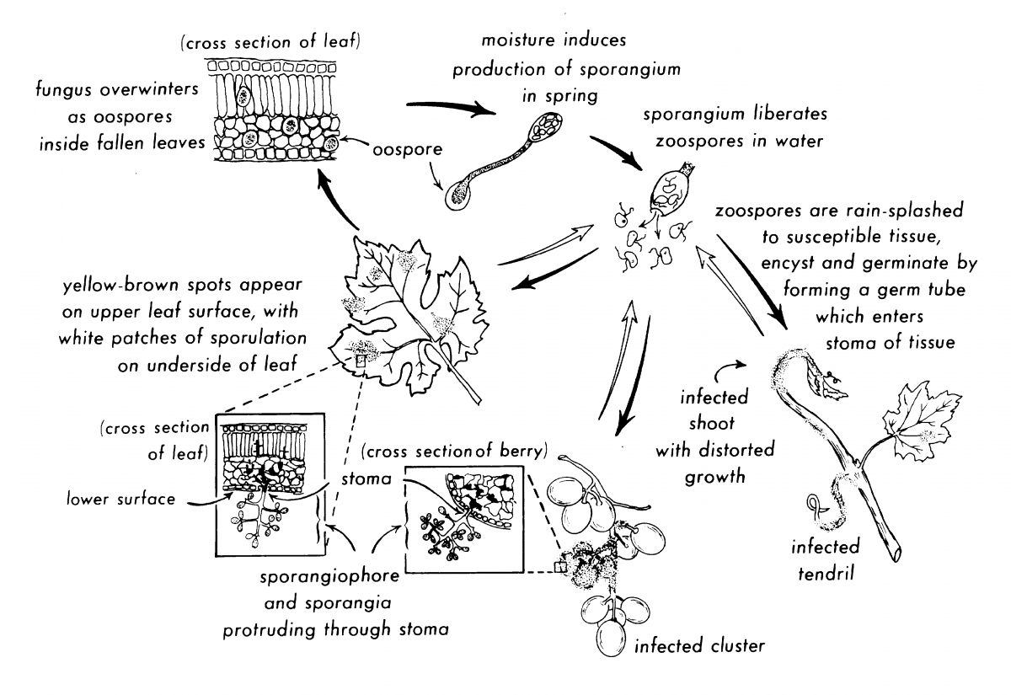
Life Cycle of Downy Mildew
Adapted from Grape IPM Disease Identification Sheet No. 5.

Slide 11
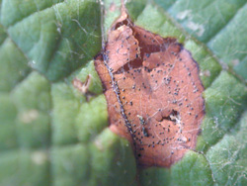
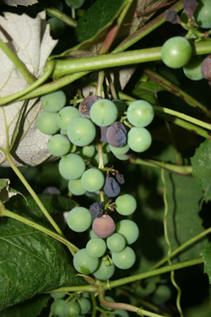
Black rot (leaf and fruit)
Epidemics can cause major yield losses
Diagnostic symptoms:
- Red leaf spot with very small black bodies
- Blackening of immature berries starting early in the season
Pre-bloom to 2 weeks post bloom is the most critical spray time
Berries become resistant with age: may have to spray until 6 weeks post bloom
Effective fungicides: Abound, Sovran, Flint, Mancozeb, Rally etc.
FACT SHEET FOR BLACK ROT: https://grapesandwine.cals.cornell.edu/newsletters/appellation-cornell/2014-newsletters/issue-17/managing-black-rot

Slide 12
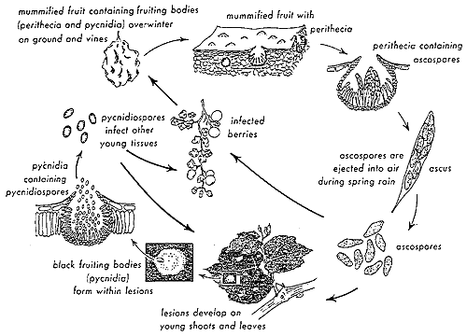
Life Cycle of Grape Black Rot

Slide 13
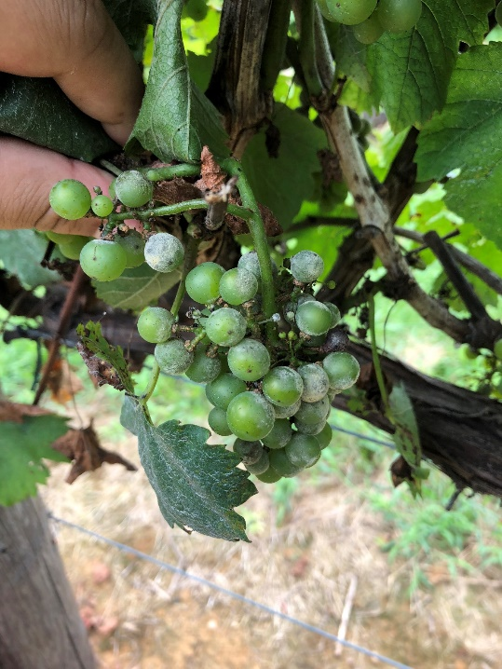
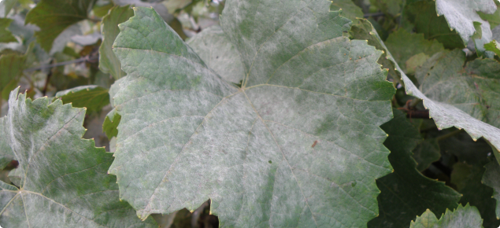
Powdery mildew (leaf and fruit)
Generally less important in Mid-Atlantic region
Diagnostic symptoms:
- Vary with the source of inoculum, tissue age, and the age of the mildew colony
- Characteristic powdery or dusty appearance
2 to 6 weeks following bud break typically is the most critical spray time in the Mid- Atlantic
Effective fungicides: Sulfur, Vivando, Luna Experience, Procure, Rally etc.
FACT SHEET FOR POWDERY MILDEW: http://www.practicalwinery.com/marapr03/marapr03p16.htm

Slide 14
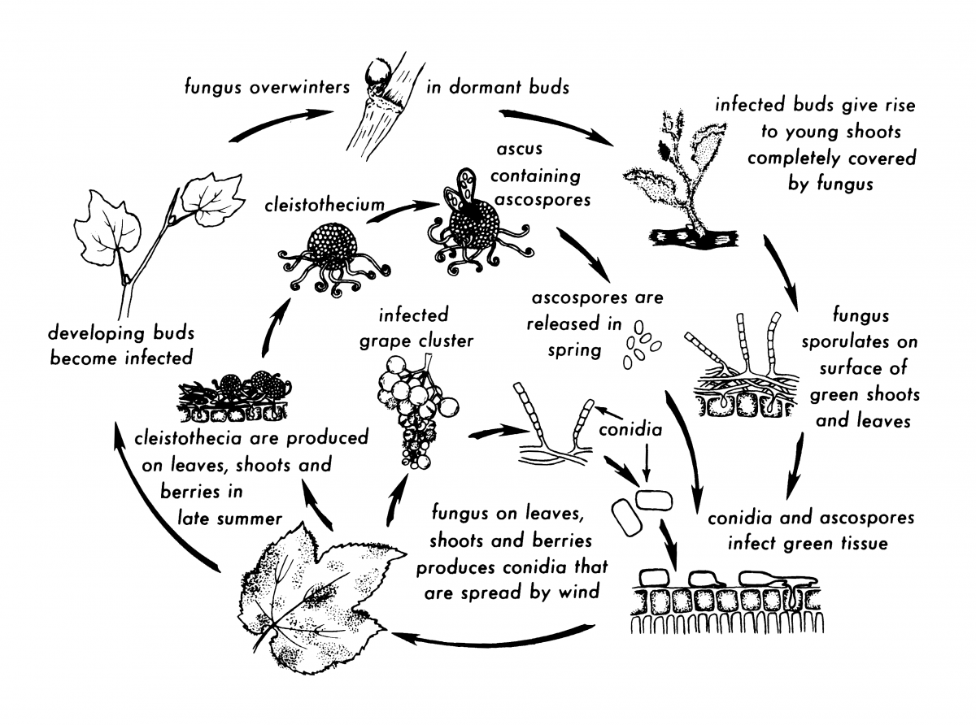
Life Cycle of Powdery Mildew
Adapted from Grape IPM Disease Identification Sheet No. 2.

Slide 15
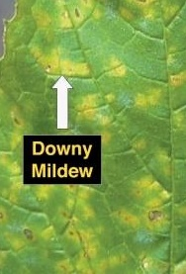
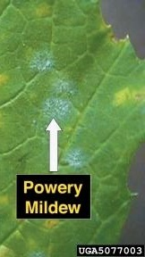
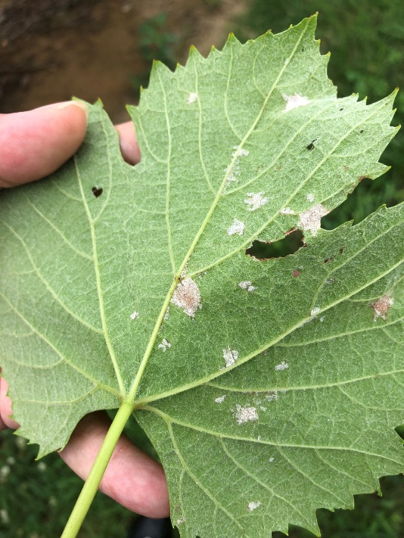
Downy mildew is easily confused with Powdery mildew
Controlled VERY differently
How to tell them apart:
DOWNY: White mildew is on leaf underside
POWDERY: White mildew is on leaf top

Slide 16
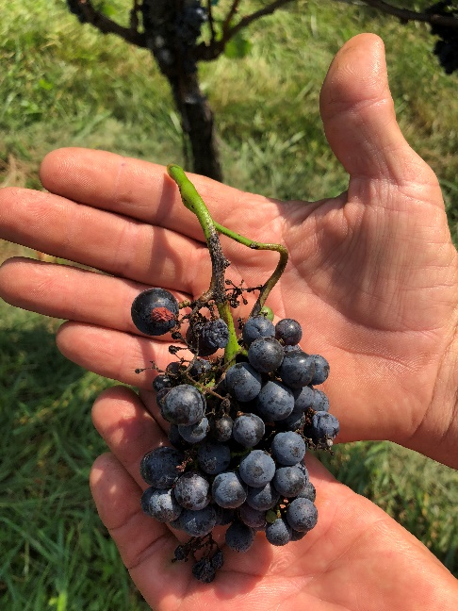
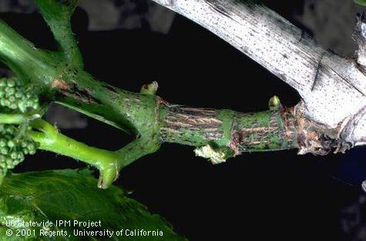
Phomopsis cane and leaf spot (and fruit spot)
Diagnostic symptoms:
-Black spots and scabs on green shoot
-Old shoots bleached with black spots
Inoculum in wood and canes
Sanitation is important (Dormant pruning)
Spray from 1” shoot growth through fruit set (Broad-spectrum protectants)
Effective fungicides: Mancozeb, Captan etc.
FACT SHEET FOR PHOMOPSIS: http://nysipm.cornell.edu/factsheets/grapes/diseases/phomopsis.pdf

Slide 17
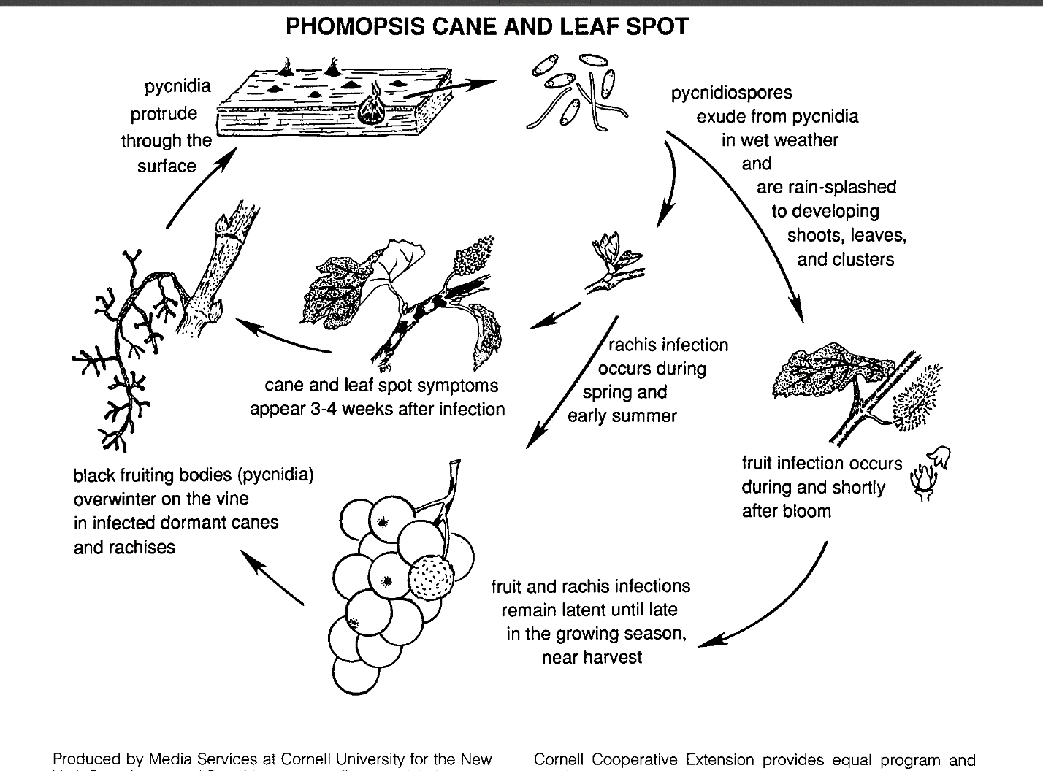
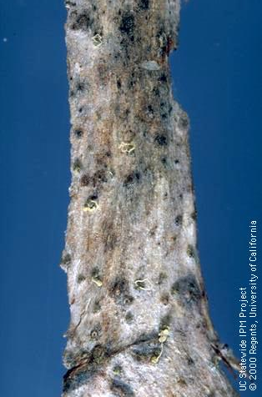
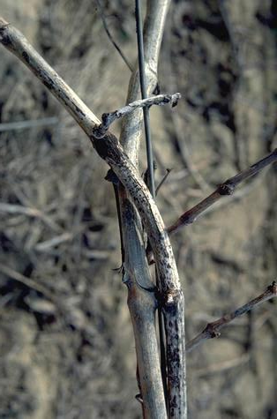
Extremely local dispersal; monocyclic nature of this disease

Slide 18
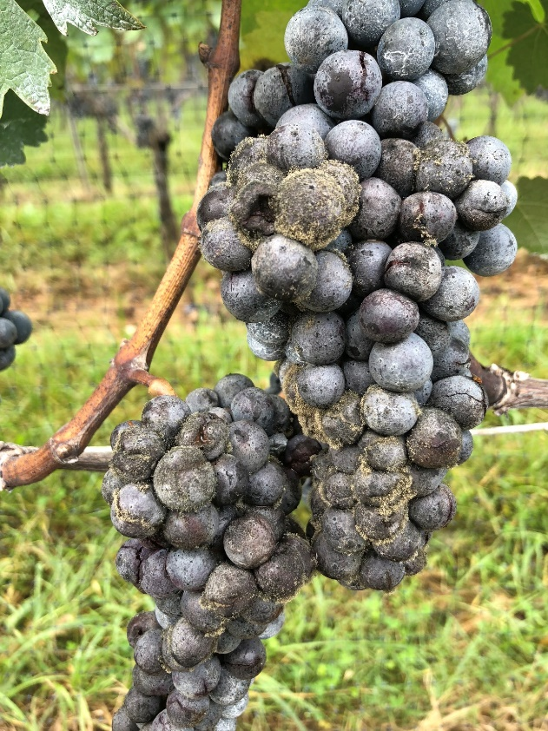
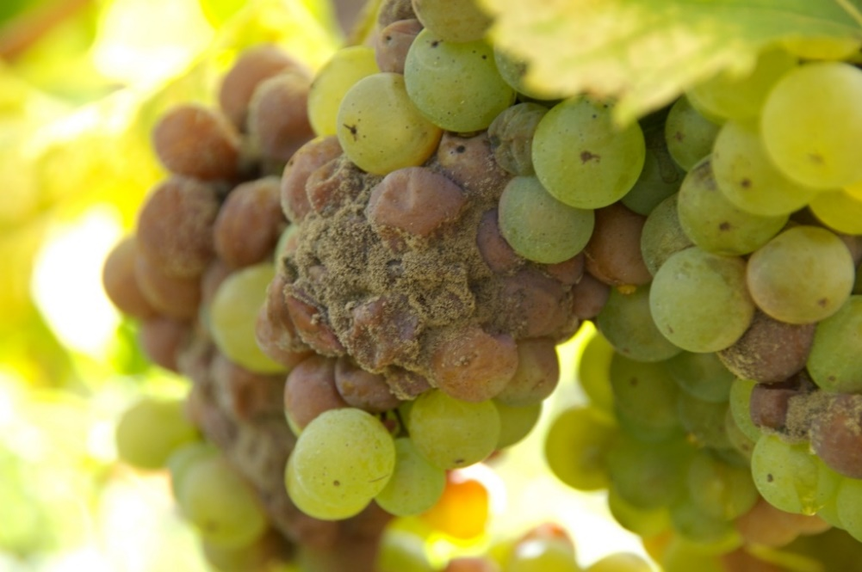
Late-season rots
1. Botrytis bunch rot (caused by Botrytis cinerea)
Diagnostic symptoms
-Fruit turning brown at first followed by production of gray spores
Often occurs after varaison as fruit is nearing harvest
Overwinter as sclerotia in berry mummies or as dormant mycelium in plant debris
Largely relies on fungicide control, but resistance issues are common
Effective fungicides: Captan, Switch, Kenja, Luna Experience etc.

Slide 19
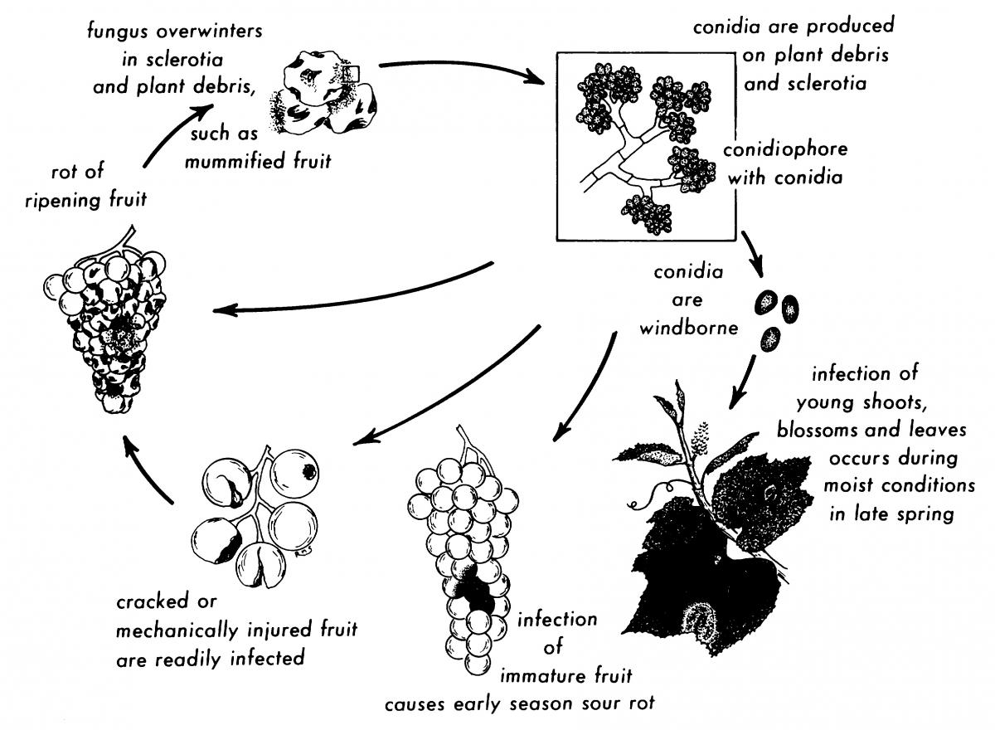
Life Cycle of Botrytis Bunch Rot

Slide 20
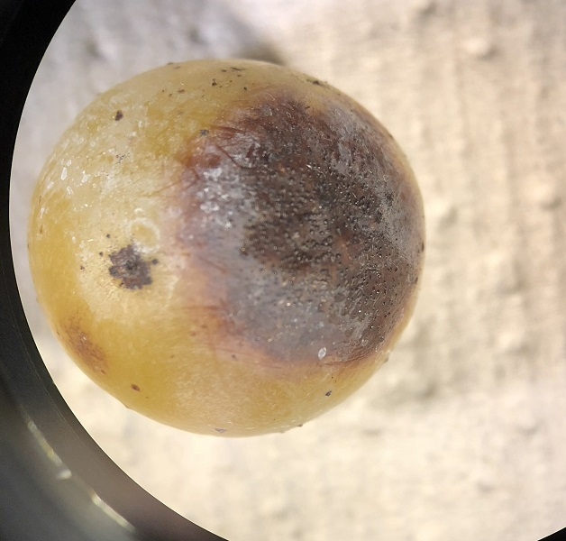
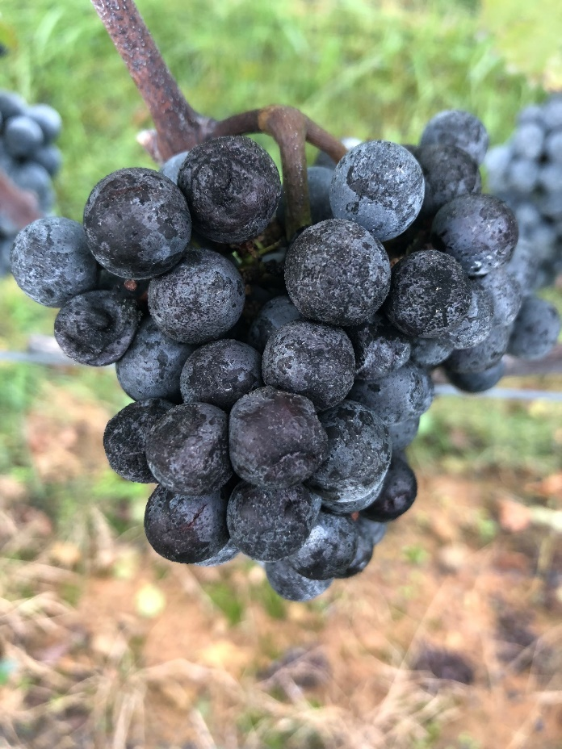
2. Ripe rot (caused by Colletotrichum spp.)
Symptoms: berry shriveling and browning; black specks on surface
Overwinters in mummified fruit or plant debris
Dispersal by water splash and/or wind
Infection can occur anytime from bloom to harvest

Slide 21
Disease Cycle of Blueberry Ripe Rot
Illustration by Jennifer Pagan

Slide 22
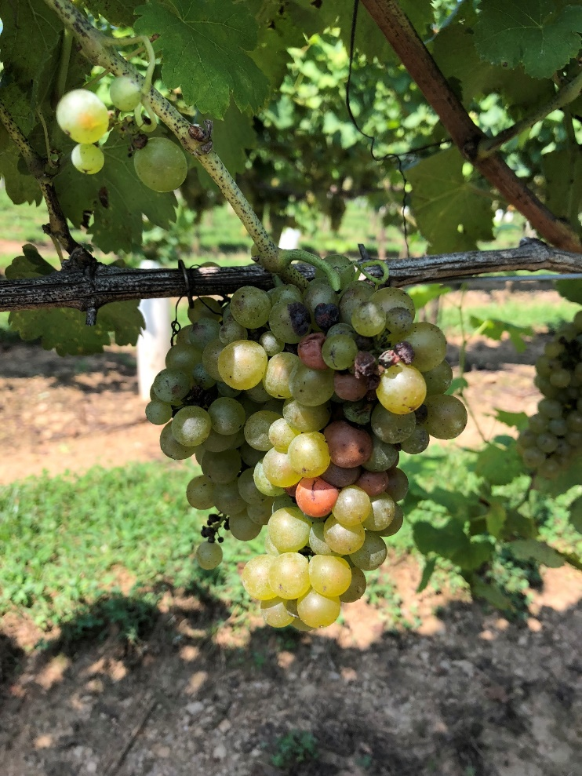
3. Sour rot (disease complex)
Characterized by sour odor
Considered to be a disease complex, consisting of insect damage (fruit flies), bacterial and fungal infections.
No fungicides available
  Good control of fruit flies after 15° Brix may be helpful

Slide 23
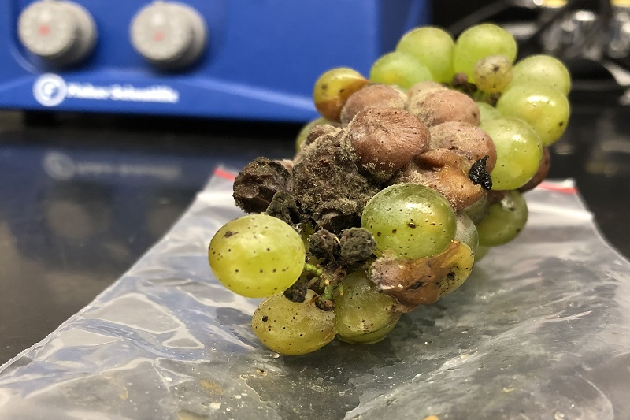
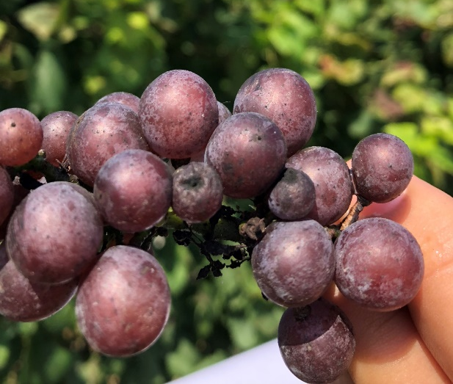
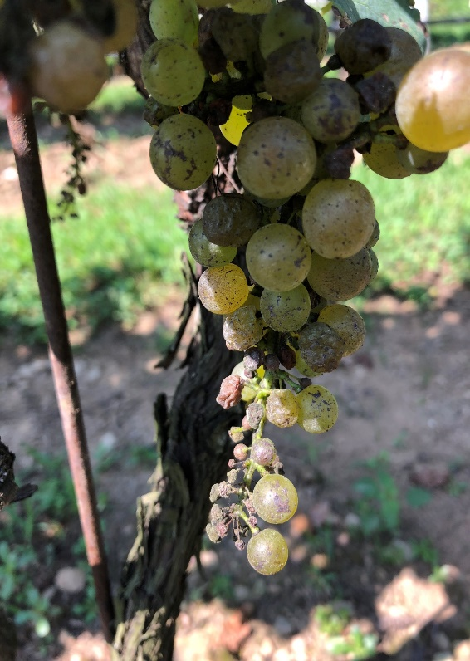
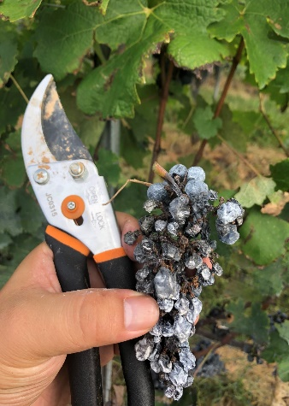
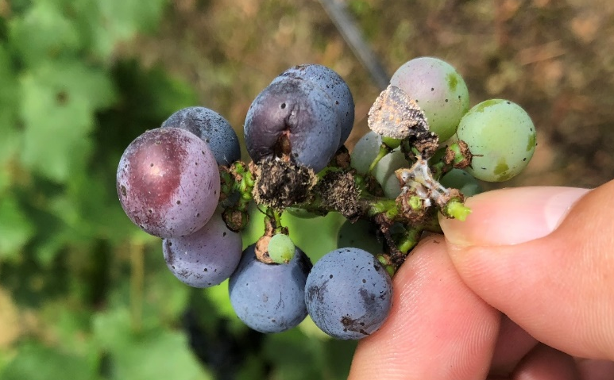
4. Other late season rots
In an association with secondary pathogens such as Alternaria, Aspergillus, and Penicillium….
Secondary pathogens normally need entry points to infect

Slide 24
A schematic diagram of fungicide spray schedule
Captan + Quintec
Mancozeb
Inspire super
Switch
Mancozeb + sulfur (2x)
Captan + Luna Exp
Aprovia + Captan
Lime sulfur or Topsin-M
Zampro
Revus
sprays
Dormant Budbreak Pre-bloom Bloom Post-bloom Bunch closure Veraison Pre-harvest
Black rot
Phomopsis
Powdery mildew
Downy mildew
Botrytis and late season rots
FRAC codes included:
M3 (3x), M4 (3x), FRAC 1 (1x), FRAC 3 (2x), FRAC 7 (2x), FRAC 9 (1x), FRAC 12 (1x), FRAC 40 (2x) FRAC 45(1x)
Preventative sprays are of paramount importance!
Fungicides should be applied before disease occurs!

Slide 25
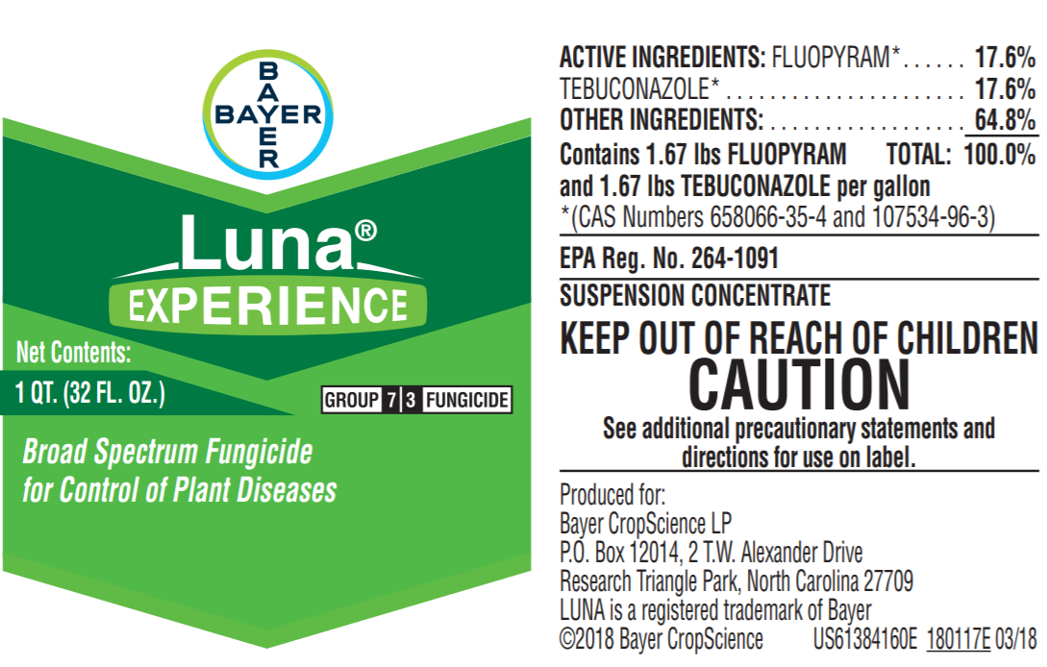
A fungicide label

Slide 26
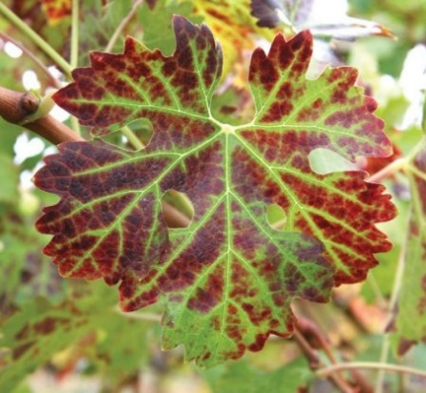
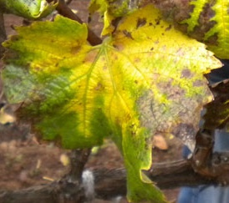
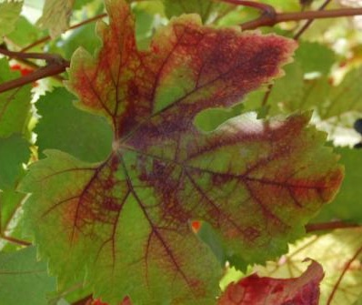
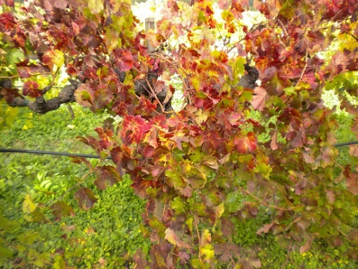
Management of other important diseases in the region
Grapevine leaf roll virus
Certified clean vines
About 25% of vines with premature senescence symptoms are GvLR
Mealy bug vectored in the vineyard
Grapevine red blotch virus
Recently described disease
About 21% of vines with premature senesce symptoms are GvRB—hard to distinguish from GvLR
VA creeper leafhopper and Spissistilus festinus vectored in the vineyard
FACT SHEETS: http://www.nysipm.cornell.edu/factsheets/grapes/diseases/grape_leafroll.pdf
http://fpms.ucdavis.edu/WebSitePDFs/news/RedblotchFactSheet.pdf

Slide 27
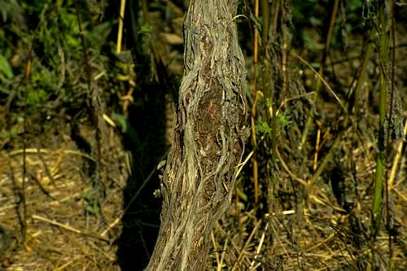
Crown Gall: caused by Agrobacterium vitis (trunk disease)
-A big problem in cold years: facilitated by winter injury
-Kills vines; No chemicals are truly effective.
-Clean stock; avoid cold locations for sensitive varieties
FACT SHEET: http://nysipm.cornell.edu/factsheets/grapes/diseases/crown_gall.pdf

Slide 28
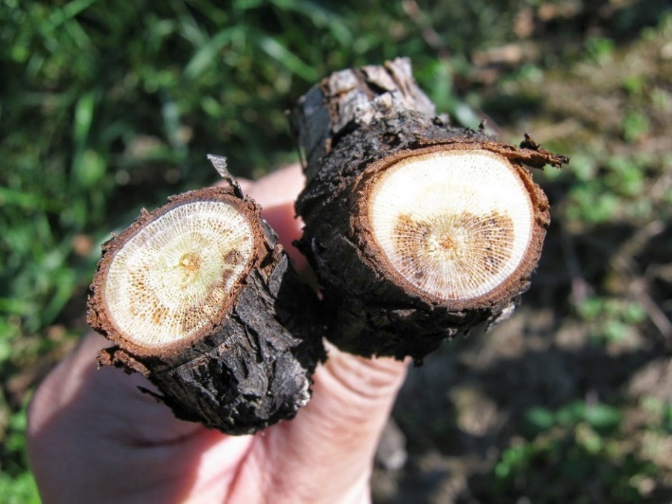
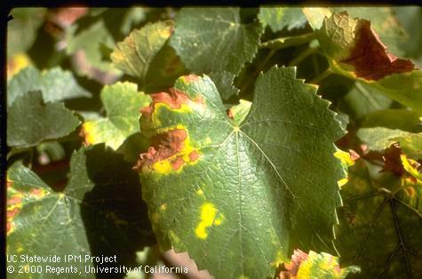
Trunk cankers (many fungi)
- Will reduce longevity of vineyards over time
- Present in ~15% of vines in this region
- Control: clean vines, pruning in the spring / double pruning; minimize harvest / nutrient stress
Pierces disease (a bacteria)
- Southern and eastern shores
→ Insect vector survives on alternate hosts
- Control: cut out diseased canes
Minor viruses
- Clean nursery stock

Slide 29
Putting It All Together
Use an integrated approach: Proper canopy management, biological controls, good variety selection, sanitation, and fungicides.
Target fungicide applications on current and near term weather, growth stage, disease pressure and environment.
Use spray guides to develop an initial plan and modify as the season develops
Limit each mode of actions to 2 times per season. Pay attention to reports of fungicide resistance in your area.

Slide 30
Putting It All Together
Expect 5-8 fungicide applications the first and second year
Expect 12-16 fungicide applications for years 3 +
Accurate disease diagnosis is impotant
Organic grape production is challenging due to the high disease pressure in our area. Organic producers will still need to apply multiple sprays using OMRI approved products

Slide 31
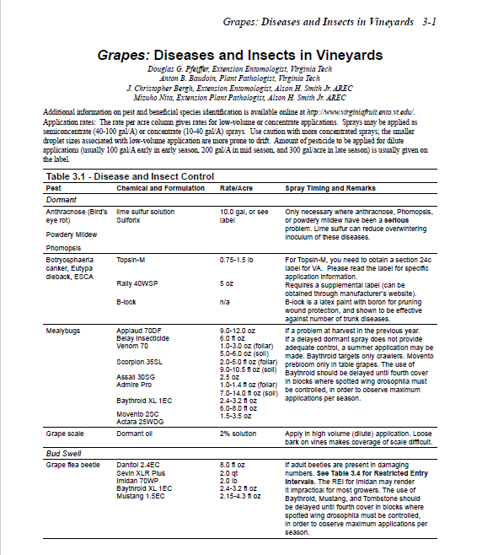
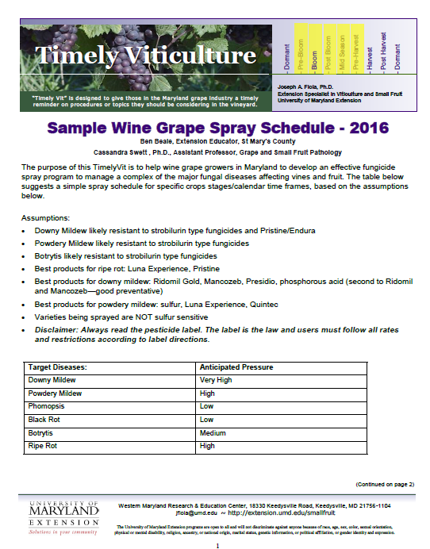
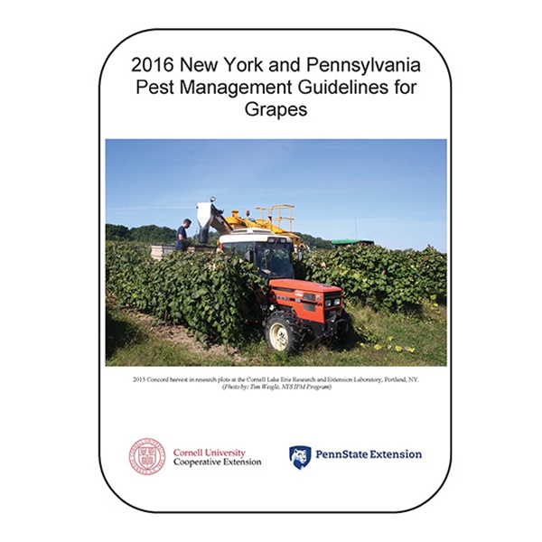
Extension articles/disease management guidelines

Slide 32
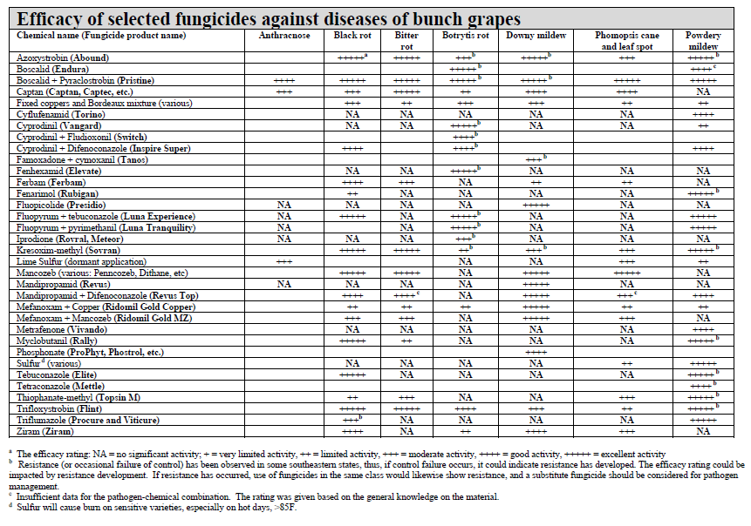
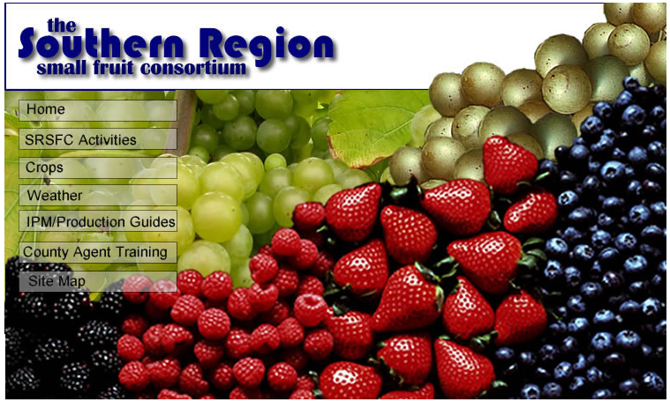
Regional spray guides
http://www.smallfruits.org/ipm-guides.html

Slide 33
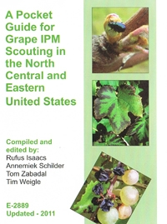
Books / other resources
A Pocket Guide for Grape IPM Scouting of Grapes in North Central & Eastern U.S.
APS Compendium of Grape Diseases
Vineyard Pest Management Tool Kit. VineSmith Vineyard Services. Available for $64.00+ S&H from http://www.vinesmith.com/tool-kit
Guidelines for Developing an Effective Fungicide Spray Program for Wine Grapes in Maryland, 2012 (+ 2013 update)

Slide 34

MyIPM Smartphone Application
A tool to facilitate communications of IPM (Integrated Pest Management) practices and improve fungicide resistance management
Main features:
Active Ingredient and Tradename tables
High-quality disease pictures
Fungicide Efficacy, PHI, REI, Rate, and Toxicity info
Pest Biology ….
A Live Demo……
Free
Notes:
An app to deliver IPM information

Slide 35



Slide 36



Slide 37








Active Contributors
Crop/other | Diseases | Insects
Apple | Dan Cooley, Jon Clements, Kari Peter, and Sara Villani | Greg Krawcyk, Brett Blaauw, and Jaime Pinero
Blackberry | Jonathan Oliver
Blueberry | Jonathan Oliver and Bill Cline | Ash Sial
Bunch grapes | Mengjun Hu | Jaime Pinero
Cherry | Kari Peter
Cranberry | Sai Sree Uppala
Peach | Guido Schnabel, Mengjun Hu and Phil Brannen | Brett Blaauw
Pear | Kari Peter | Elizabeth Garofalo
Strawberry | Guido Schnabel and Mengjun Hu | Rebecca Schmidt-Jeffris
Technical | Greg Edison (Programmer), Madeline Dowling (Design), and Joe LaForest (SRIPM Center; logistics)

Slide 38

Any questions?
Mengjun Hu
Grape and Small fruit Pathologist; Extension Specialist,
2106 Plant Sciences Building,
University of Maryland,
College Park, MD 20742
Email: mjhu@umd.edu
Cell: 301-892-0213
Office: 301-405-5586

