Slide 1
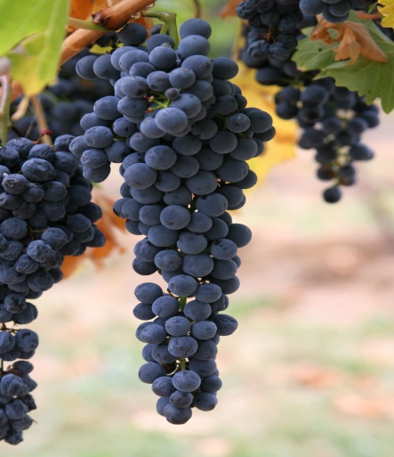
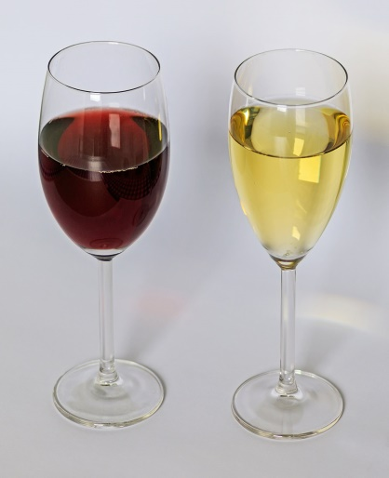
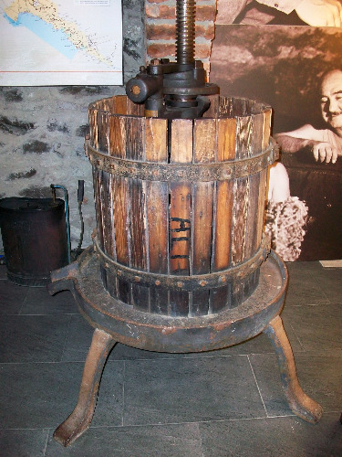
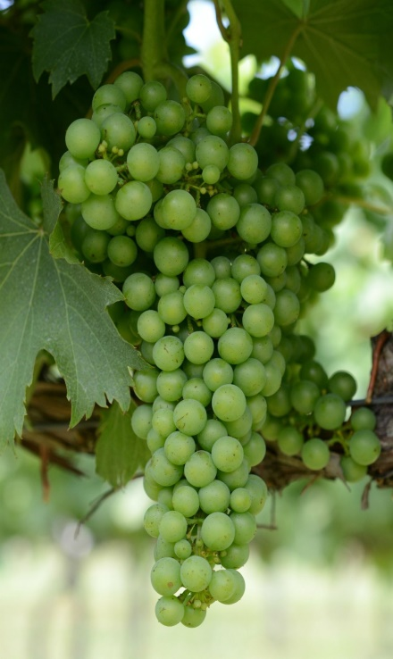
WINE MAKING FOR THE
GRAPE GROWER
101

Slide 2
Why Should Grape Growers Make Wine?
To get a better understanding of how fruit quality relates to wine quality.
How to properly analyze fruit to determine level of ripeness and harvest time estimates
Increases confidence of the buyer that the grower fully understands what they are doing.
Weekly Status Reports to Winery!

Slide 3
What Do We Test For?
Sugar Content – Brix. Use a Refractometer 20+ 22-24 optimal for most varietals
Specific Gravity – Another method for Sugar Content, more so for winemaking. Use a Hydrometer 1.075-1.100 starting Points.
Acid Strength – pH. Use a pH Meter. 3.1-3.4 Whites, 3.4-3.7 Reds. Calibration required
Titratable Acid (T/A) – Use Titration Burette 5-8 g/l
Personal Senses – Flavors, Aromas, Colors, Seed Colors, Skin and Seed Tannins - Chew

Slide 4
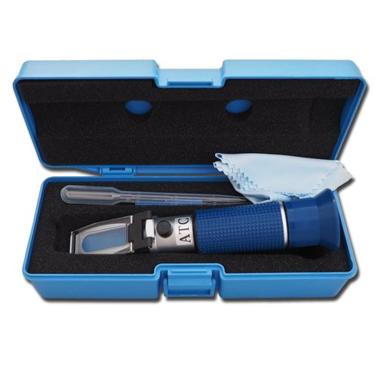
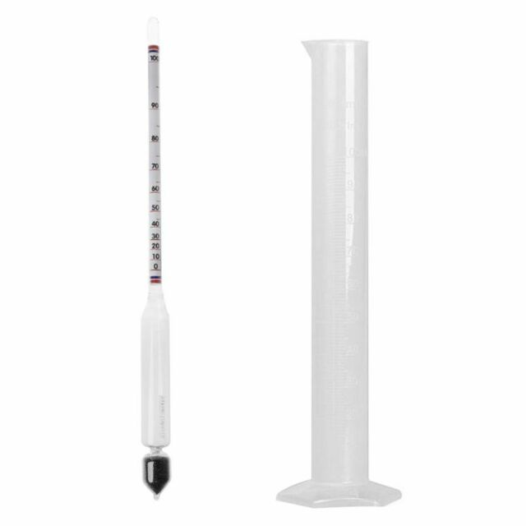
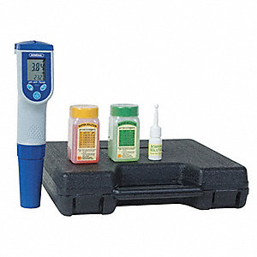
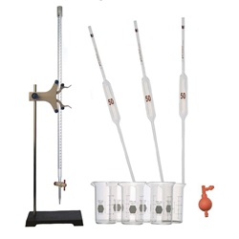

Slide 5
Record Keeping is Critical for QUALITY Improvement
Tonnage – Good Crop Estimates
Number of Clusters per vine
Cluster Weights
Pruning Styles
Canopy Management Adjustments

Slide 6
Fruit Sampling
Determine a sampling route, use the same route for consistency to track progress.
Berry Sampling, 200 berry minimum. Collect from all points of the clusters.
Cluster Samples, 20-30 clusters (vineyard size).
1st vine - 1st shoot - lower cluster
2nd vine – 2nd shoot – upper cluster
3rd vine – 3rd shoot –lower cluster
4th vine – 4th shoot –upper cluster……
Do not sample end vines or end rows.

Slide 7
Fruit is Ready! Lets make Wine!
Big Note!!! Make sure all pesticide Pre-Harvest Intervals are in compliance, and any special winery requests are adhered to; brix, ph, T/A.
EX: I require no Sulfur or Captain sprays with in 30 days of harvest. Can affect wine quality.
Try hard to keep grower/winery relations by constant communication. No surprises.

Slide 8
Equipment
Destemmer & Crusher; get berries off stems and crush them
Press and Strainer; squeezes juice out of the fruit
Fermentation Pails; used for red primary fermentation and white juice settling.
Carboys, various sizes; used for white fermentation and aging of both red and white.
Misc. items; Mixing paddles, syphon hoses, air locks, stoppers, funnels, scale, measuring spoons & scoops.
Sanitation Equipment; used to clean everything! Spray bottles, dip tubs, sanitizing wipes.

Slide 9
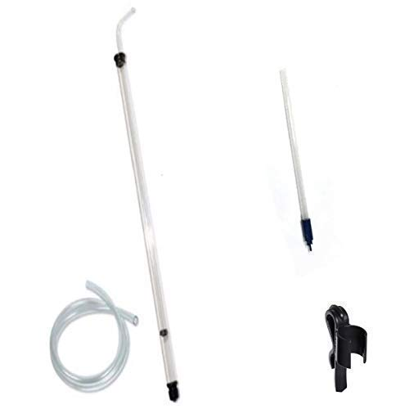
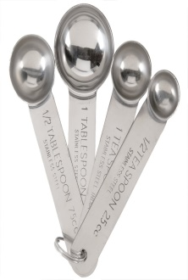
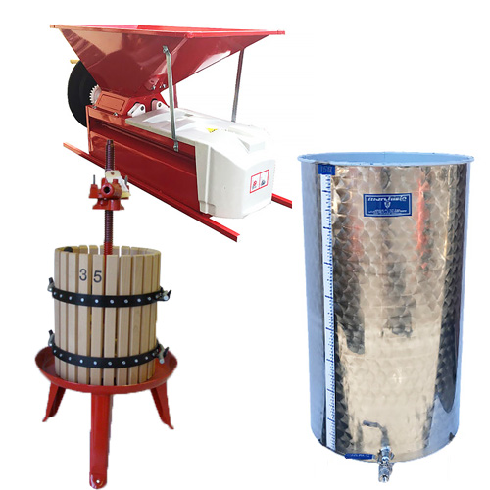
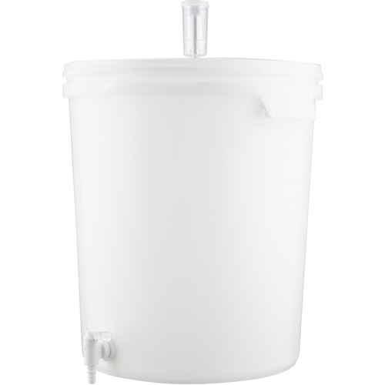
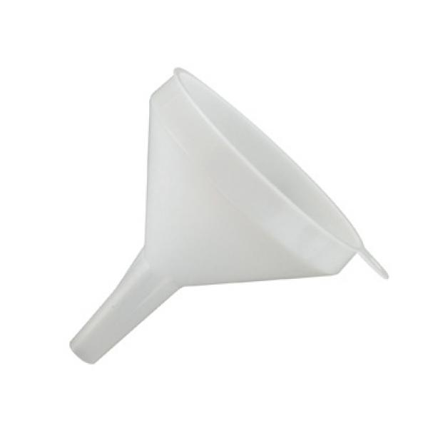
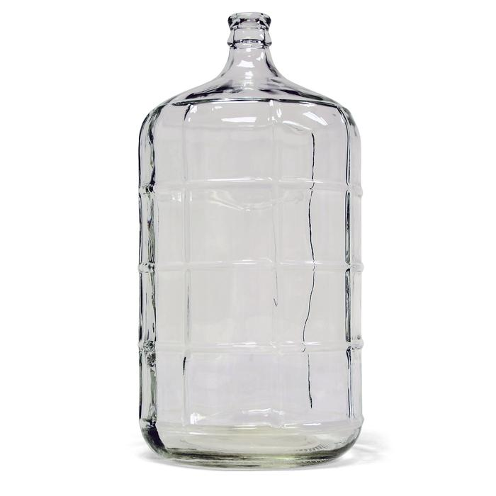
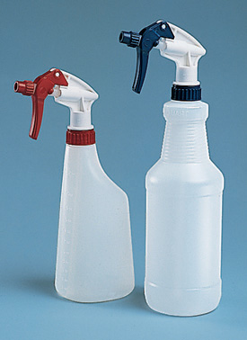
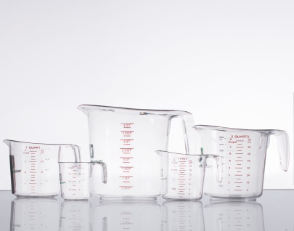

Slide 10
SANITATION
Most terrible homemade wine is usually the result of poor or no sanitation.
Clean work area
Clean equipment
Use proper cleaning/sanitizing agents.
No Chlorine Beach
Citric acid and Potassium Metabisulfite in a spray bottle. Make a gallon jug, Add 1 tbsp. of Meta and add citric acid to reduce pH to 2.8
70% Grain Alcohol is very good but expensive.

Slide 11
Additives
Yes, good wine requires the use of some additives, mainly to preserve and to eliminate “The Bad Guys”. Stray yeasts, bacteria.
All natural wines are possible, but will turn to crud soon after fermentation.
The life of Grape Juice ends at the vinegar or nail polish stage, passing through the good wine point somewhere in the middle.
A winemakers job is to stop the progression at the good wine point, and to enhance the quality.

Slide 12
Additives
Wine Yeast - countless types, 1 gr/gal.
Reds – Lalvin 71B-1122 -Fruity, Lalvin D-47 - Complexity
Whites – Red Star Cotes de Blanc –Fruity, Lalvin R-2 – Germanic styles
Go-Ferm - Yeast Hydration Food 1.1 gr per 1 gr yeast x 15 mils water.
Yeast Nutrient – Yeast food during Fermentation, Superferment 1 gr/gal. Diammonium Phosphate aka DAP. 2 gr/gal if wine gets an H2S aroma during fermentation.
Acid Blend/Tartaric Acid – Adjust pH
Malolactic Fermentation Bacteria MLFB & Nutrient “Chromography Test Kit” High acid wines

Slide 13
Additives
Pectic Enzyme – Helps Break down the fruit for better extraction in reds and helps with settling lees in whites. Zyme-o-color & clear.
Potassium Metabisulfite META (SO2) ¼ tsp = approx 40 ppm per 5 gallons. Free Sulfur Tests, Kills Bacteria, hinders stray yeast.
Potassium Sorbate – Sweet Wines At Bottling Kills stray yeasts, stops fizzy wines. 1 gr/gal.
Fining/Clearing Agents – Bentonite, PVPP, Kieselsol & Chitosan (2 part packets)
Potassium Bitartrate– Cold Stabilizing Tartaric Crystals 1gr/gal

Slide 14
PICK CLEAN FRUIT! Remove Bad Fruit, Destem & Crush
White Wines
12-15 LBs/Gal
Press off juice into 5 gal Ferment Pail
Test juice starting points (SG, Brix, pH & T/A)
Add ¼ tsp Meta and Pectic Enzyme to juice
Place juice into cold area for settling 24 hrs. 40F
Rack off clearer Juice into another pail
Let Juice warm to room temp, adjust Sugar & Acid
Red Wine
10-12 LBs/Gal
Place crushed fruit (Must) into 5 gal Ferment Pail
Test Must starting points (SG, Brix, pH & T/A)
Add ¼ tsp Meta and Pectic Enzyme to Must
Place Must into cold area for 24 hrs. 40F
Let Must warm to room temp, adjust Sugar & Acid

Slide 15
Prepare The Yeast
Yeast must be hydrated in lukewarm water 85-100 degrees.
Recommend using a hydration additive such as Go-Ferm, add to lukewarm water before adding yeast.
Slowly stir in yeast, let stand for 20 minutes stirring occasionally. No clumps
Add a Yeast Nutrient such as Super Ferment to the juice or must, not the yeast mixture!
50% at start, 50% halfway through fermentation

Slide 16
Don’t forget SANITATION in every step!
White Wines
Add Yeast Hydration mixture to juice, no more than a 20F difference between mix and juice.
Cover Loosely
Stir lightly Daily – O2
Monitor temperature, keep below 75F
Add 2nd 50% of yeast Nutrient About 3-4 days
When Ferment is complete, Rack off wine into carboy
Test Wine Chemistry SG/pH/TA
Add ¼ Tsp Meta - test Free SO2
Fit Airlock
Red Wines
Add Yeast Hydration mixture to Must, no more than a 20F difference between mix and juice.
Cover Loosely
Punch Down twice Daily
Monitor temperature, keep below 75F
Add 2nd 50% of yeast Nutrient About 3-4 days
*Add MLFB and Nutrient*
When Ferment is complete, (Cap Sink) Press off wine into carboy
Test Wine Chemistry SG/pH/TA
Add ¼ Tsp Meta* - test Free SO2
OAK Additives
Fit Airlock

Slide 17
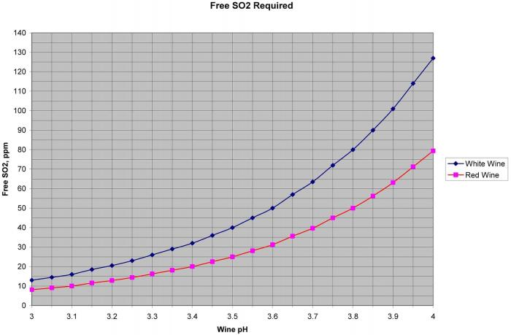

Slide 18
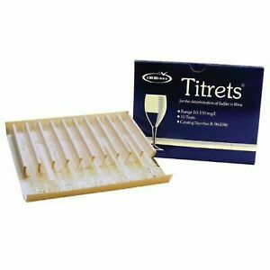

Slide 19
Let The Wine Settle
As the lees form on the bottom of the carboy, rack it off monthly then bi-monthly as needed. DON’T over rack!
As much as you want to hurry the process along, it just takes time, be patient. Whites 6+ mos, Reds as much as a year.
Each time you rack check the free SO2 level and adjust. ¼ tsp meta = approx 40 ppm per 5 gallons
Final clearing with a fining agent can be done prior to cold stabilizing. Bentonite, 2 Part Agent, egg whites, etc. and rack off.

Slide 20
Cold Stablization
This process removes excess tartaric acid that will crystalize making “Wine Diamonds”.
Make sure your pH is where you want it.
Add a seeding agent such as Potassium Bitartrate to help the crystals to form sooner.
Place carboy into a cold storage for two weeks, colder the better (above 26 Degrees)
Remove from cold, and rack off (Filter).

Slide 21
Bottling
Thoroughly clean the bottling space!
Make sure your bottles are properly cleaned, especially if you are using USED bottles.
Rinse with SO2 & citric mixture.
If making sweet wine, add sugar to desired SG and Potassium Sorbate, make sure SO2 levels are correct. Make sure they dissolve completely.
Make sure corks and corker are clean.
Make sure you are clean, especially the hands.
Fill bottles so you have no more than 1 inch below the cork, Ullage.
Rinse cork in solution and insert.
Keep bottles upright for a couple days to prevent seepage.

Slide 22
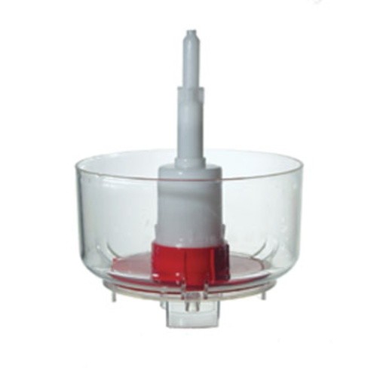
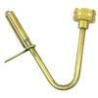
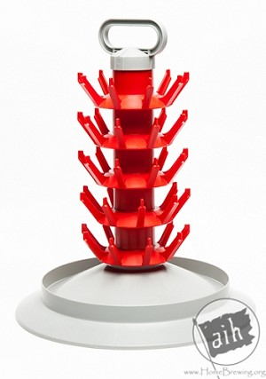
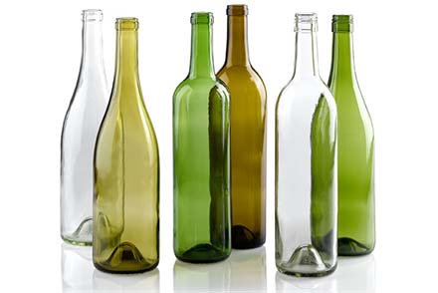

Slide 23
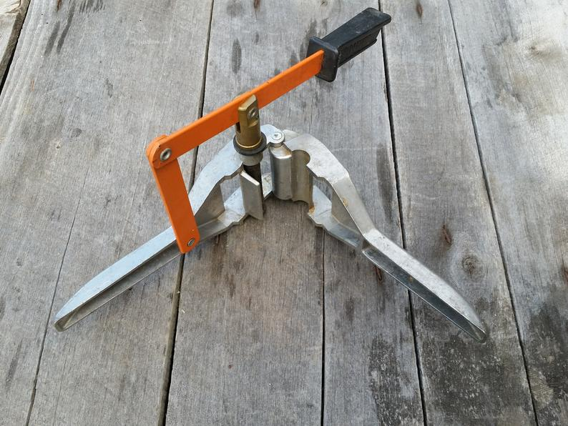
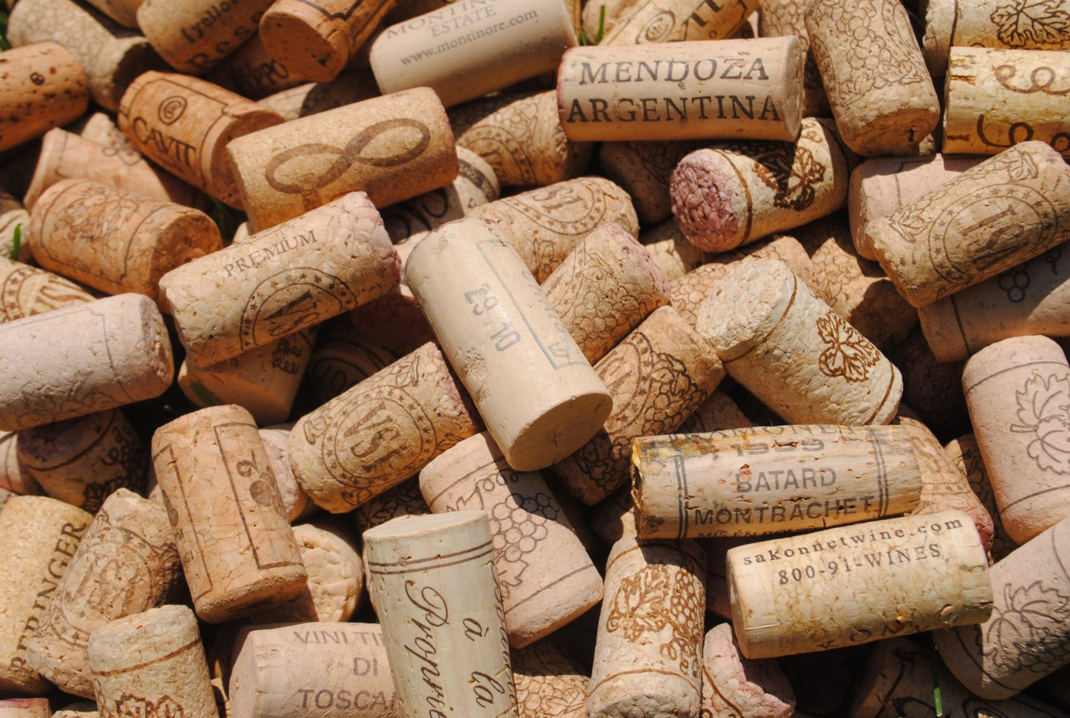
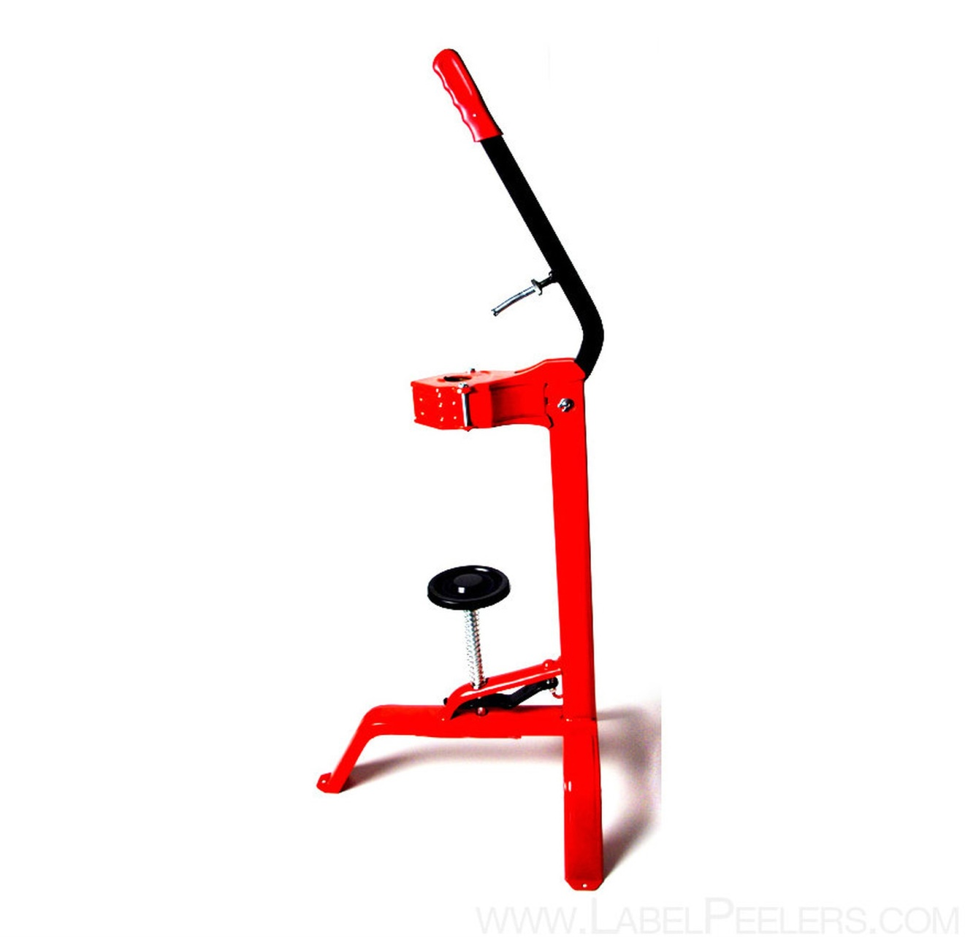
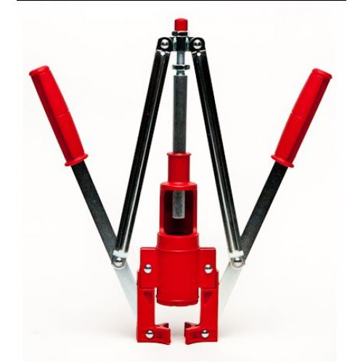

Slide 24
